Slide 1


SCST1223
Probability & statistical data analysis
CHAPTER 5
Part 1
POINT ESTIMATION & INTERVAL ESTIMATOR
Innovating Sustainable Solutions

Slide 2
Preview
In Chapters 1, there are 2 main branches of statistics which are Descriptive and Inferential.
In Chapter 4, we used descriptive statistics when we summarized data using tools such as graphs and statistics such as the mean and standard deviation.
In inferential statistics, the two major activities of inferential statistics are (1) to use sample data to estimate values of a population parameters, and (2) to test hypotheses or claims made about population parameters.
2

Slide 3
What Are Point and Interval Estimates of Population Parameters?
3

Slide 4
Point Estimate
A point estimate is a single number that is our “best guess” for the parameter.
4

Slide 5
Interval Estimate
An interval estimate is an interval of numbers within which the parameter value is believed to fall.
5

Slide 6
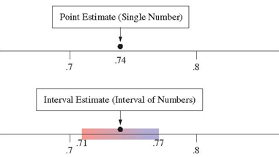
Point Estimate vs Interval Estimate
A point estimate predicts a parameter by a single number.
An interval estimate is an interval of numbers that are believable values for the parameter.
Question: Why is a point estimate alone not sufficiently informative?
6

Slide 7
A point estimate doesn’t tell us how close the estimate is likely to be to the parameter.
An interval estimate is more useful.
It incorporates a margin of error which helps us to gauge the accuracy of the point estimate.
7

Slide 8
Point Estimation
How do we make a best guess for a population parameter?
Use an appropriate sample statistic:
For the population mean, use the sample mean
For the population proportion, use the sample proportion
Point estimates are the most common form of inference reported by the mass media.
8

Slide 9
Properties of Point Estimators
Property 1: A good estimator has a sampling distribution that is centered at the parameter
An estimator with this property is unbiased
The sample mean is an unbiased estimator of the population mean
The sample proportion is an unbiased estimator of the population proportion
Property 2: A good estimator has a small standard error compared to other estimators
This means it tends to fall closer than other estimates to the parameter
9

Slide 10
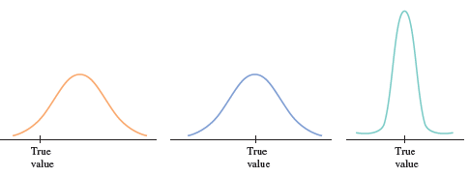
Unbiased, since the distribution is centered at the true value
Biased, since the distribution is NOT centered at the true value
10

Slide 11
Unbiased, but has a smaller standard deviation so it is more precise.
Unbiased, but has a larger standard deviation so it is not as precise.
11

Slide 12
Interval Estimation
Constructing an interval that contains the parameter (we hope!)
Inference about a parameter should provide not only a point estimate but should also indicate its likely precision
12

Slide 13
Confidence Interval (CI)
A confidence interval (CI) is an interval containing the most believable values for a parameter.
The probability that this method produces an interval that contains the parameter is called the confidence level
This is a number chosen to be close to 1, most commonly 0.95
13

Slide 14
What is the logic behind constructing a confidence interval?
To construct a confidence interval for a population proportion, start with the sampling distribution of a sample proportion.
14

Slide 15
The Sampling Distribution of the Sample Proportion
Gives the possible values for the sample proportion and their probabilities.
Is approximately a normal distribution for large random samples.
Has a mean equal to the population proportion.
Has a standard deviation called the standard error.
15

Slide 16
Margin of Error
The margin of error measures how accurate the point estimate is likely to be in estimating a parameter.
The distance of 1.96 standard errors in the margin of error for a 95% confidence interval.
16

Slide 17
Confidence Interval Estimator for Proportion
17

Slide 18
The General Properties for Sampling Distributions of p
1.
2.
As long as the sample size is less than 10% of the population
3. As long as n is large (np > 10 and n (1-p) > 10) the sampling distribution of is approximately normal.
These are the conditions that must be true in order to calculate a large-sample confidence interval for p
18

Slide 19
The Large-Sample Confidence Interval for p
We symbolize a population proportion by p
The point estimate of the population proportion is the sample proportion
We symbolize the sample proportion by
The general formula for a confidence interval for a population proportion
This is also called the margin of error/bound on the error estimation
19

Slide 20
Three Commonly Used Confidence Levels
A 90% confidence interval for a population proportion
A 95% confidence interval for a population proportion
A 99% confidence interval for a population proportion

Slide 21
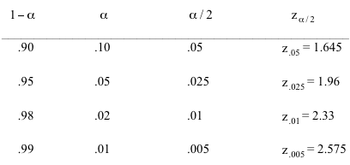
Four Commonly Used Confidence Levels
Confidence Level
cut & keep handy!
21
Notes:
How to calculate CL: https://www.google.com/search?q=how+to+read+confidence+interval+using+z+table&rlz=1C1CHBD_enMY1088MY1092&oq=how+to+read+confidence+interval+using+z+table&gs_lcrp=EgZjaHJvbWUyBggAEEUYOTIHCAEQIRigATIHCAIQIRigAdIBCTEyMjkyajBqN6gCALACAA&sourceid=chrome&ie=UTF-8#kpvalbx=_1GJJZtCkLd_C4-EPxu2EgAo_28

Slide 22
Example #1
In 2000, the GSS asked: “Are you willing to pay much higher prices in order to protect the environment?”
n = 1154 respondents, 518 were willing to do so.
Find and interpret a 95% confidence interval for the population proportion of adult Americans willing to do so at the time of the survey.
22

Slide 23
Solution
Take a sample of size n, calculate (pronounced p-hat) as the sample proportion of people who have that characteristic.
Calculate the standard error (SE).
Calculate confidence interval (i.e., 95%).
23

Slide 24
Solution
Confident interval of p-hat
24

Slide 25
Example # 2
A recent study investigated the effects of a "Buckle Up Your Toddlers" campaign to get parents to use the grocery cart seat belts. Investigators observed a representative sample of parents at grocery stores in a large city, and found 192 out of 594 parents buckling up their toddlers.
a. Compute a point estimate of the true proportion of all parents who buckle up their toddlers.
b. Construct and interpret a 95% confidence interval for the true proportion of all parents who buckle up their toddlers.
25

Slide 26

Solution
a) point estimate: = 192 / 594 = 0.3232
b) 95% CI: =
I am 95% confident that the true proportion of parents who buckle up their toddlers is between 0.286 and 0.361.
26

Slide 27
Exercise # 1
A sample of 350 students from a college (with a total student population of 25,000) were asked is either both their parents had been to college. In this case, the given sample proportion was 0.789. What is the 90% CI?
27
Notes:
The standard error is sqrt 789×(1−.789)/ 350 = 0.0218 — multiply by 1.645, the margin if error is 0.036 to three decimal places. Thus the 95% confidence interval is (0.753, 0.825).

Slide 28
Confidence Interval Estimator for Mean
28

Slide 29
Confidence Interval for mean when σ is known
The general formula for a confidence interval (CI) for a population mean when:
x is the sample mean from a random sample,
the sample size n is large (n > 30), and
σ, the population standard deviation, is known.
29

Slide 30
Example
A computer company samples demand during lead time over 25 time periods:
Its is known that the standard deviation of demand over lead time is 75 computers. We want to estimate the mean demand over lead time with 95% confidence level in order to set inventory levels.
30

Slide 31


Solution
“We want to estimate the mean demand over lead time with 95% confidence level in order to set inventory levels…”
Thus, the parameter to be estimated is the population mean:
And so our confidence interval estimator will be:
31

Slide 32
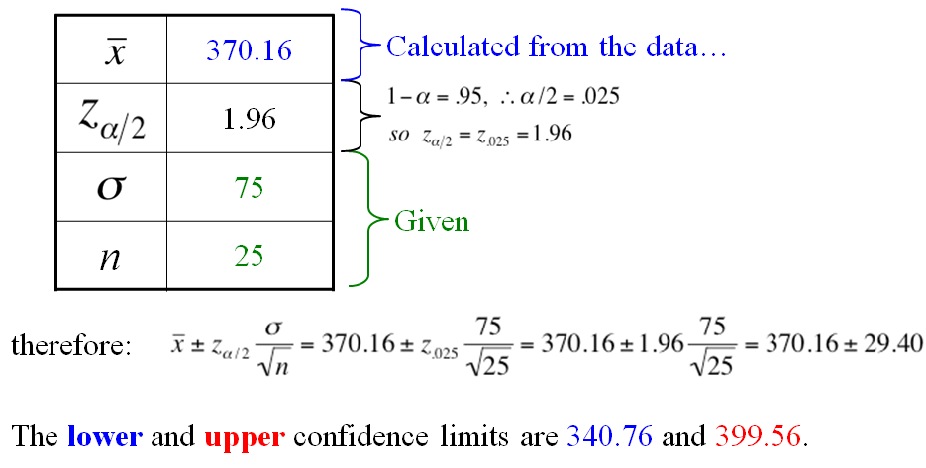
In order to use our confidence interval estimator, we need the following pieces of data:
32

Slide 33
Confidence Interval for μ when σ is unknown
The confidence interval just developed has an obvious drawback:
To compute the interval endpoints, σ must be known.
If σ is unknown, we must use the sample data to estimate σ.
If we use the sample standard deviation as our estimate, the result is a different standardized variable denoted by t:
33

Slide 34
One-sample t confidence interval for μ
is the sample mean from a simple random sample.
The population distribution is normal, or the sample size n is large (generally, n > 30), and
σ, the population standard deviation, is unknown.
One-sample t confidence interval for μ is,
where the t critical value is based on degree of freedom, df = n-1.

Slide 35
Example
The article “Chimps Aren’t Charitable” (Newsday, November 2, 2005) summarized the results of a research study published in the journal Nature. In this study, chimpanzees learned to use an apparatus that dispersed food when either of two ropes was pulled. When one of the ropes was pulled, only the chimp controlling the apparatus received food. When the other rope was pulled, food was dispensed both to the chimp controlling the apparatus and also a chimp in the adjoining cage. The accompanying data represent the number of times out of 36 trials that each of seven chimps chose the option that would provide food to both chimps (charitable response).
23 22 21 24 19 20 20
Compute a 99% confidence interval for the mean number of charitable responses for the population of all chimps.
35

Slide 36
Solution
Data: 23 22 21 24 19 20 20
= 21.29 and s = 1.80
df = 7 – 1 = 6 ; confidence level = 99% (α=0.01)
We are 99% confident that the mean number of charitable responses for the population of all chimps is between 18.77 and 23.81.
36

Slide 37
Exercise # 2
A new species of sea crab has been discovered, and an experiment conducted to determine whether or not the animal can regulate its temperature. If the animal can maintain a body temperature different from the surroundings, this would be considered evidence of regulating capability. Ten of these sea crabs were exposed to ambient temperatures of 24 degrees Celsius. Their body temperatures were measured with the results below:
24.33, 24.61, 24.67, 24.64, 24.42, 24.97, 25.23, 24.73, 24.90, 24.44
For purposes of this example, assume that it is reasonable to regard
these 10 crabs as a random sample from the population of all crabs
of this species.
a) Calculate a point estimate of the population mean, μ
b) Construct and interpret a 99% confidence interval for μ.
37

Slide 38
Exercise # 3
Logging activity in forests is thought to affect the behavior of black bears (Ursus americanus). An important measure of animal behavior is the home range, the area used by animals in their lives. In a study of black bears in a logged Canadian forest, the spring and early summer home range (in) of 12 radio-collared female black bears was measured with the following results:
39.9, 23.5, 42.1, 29.4, 34.4, 40.9, 27.9, 22.3, 13.0, 20.1, 13.3, 8.6
a) Construct and interpret a 95% confidence interval for the mean home range of female black bears in this logged forest.
b) The typical home range of females in forests with no logging is 20. Based on the confidence interval from part (a), do you think that the mean home range size of females in this logged forest could be the same as the mean home range size in non-logged forests? Explain, using appropriate statistical terminology.

